Slide 1
LLM
2025

Slide 2
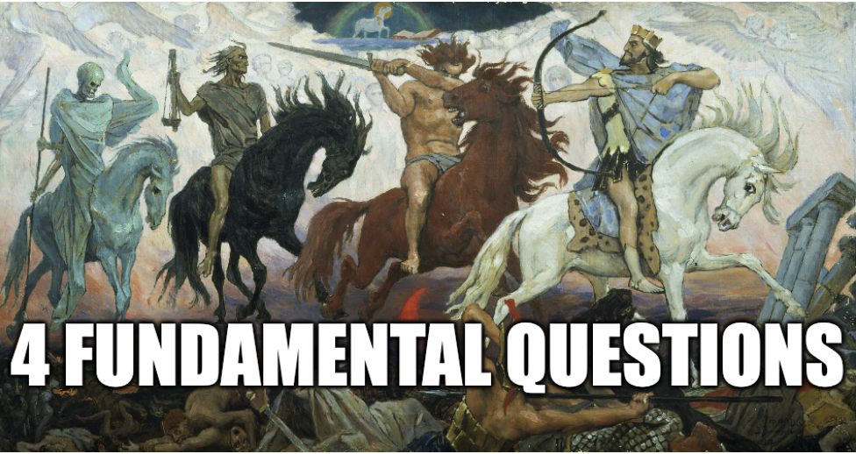
ML Basics
1.What is the input?
2.What is the output?
3.What is the model architecture?
4.What is the learning algorithm?

Slide 3
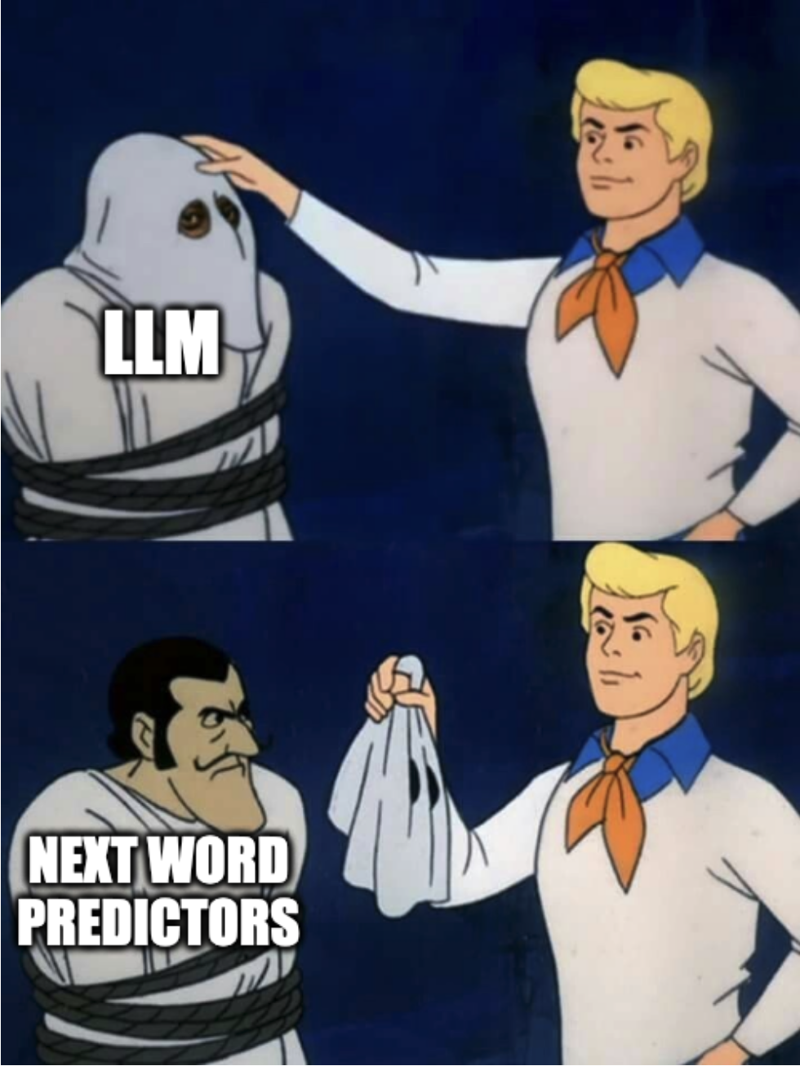

Slide 4
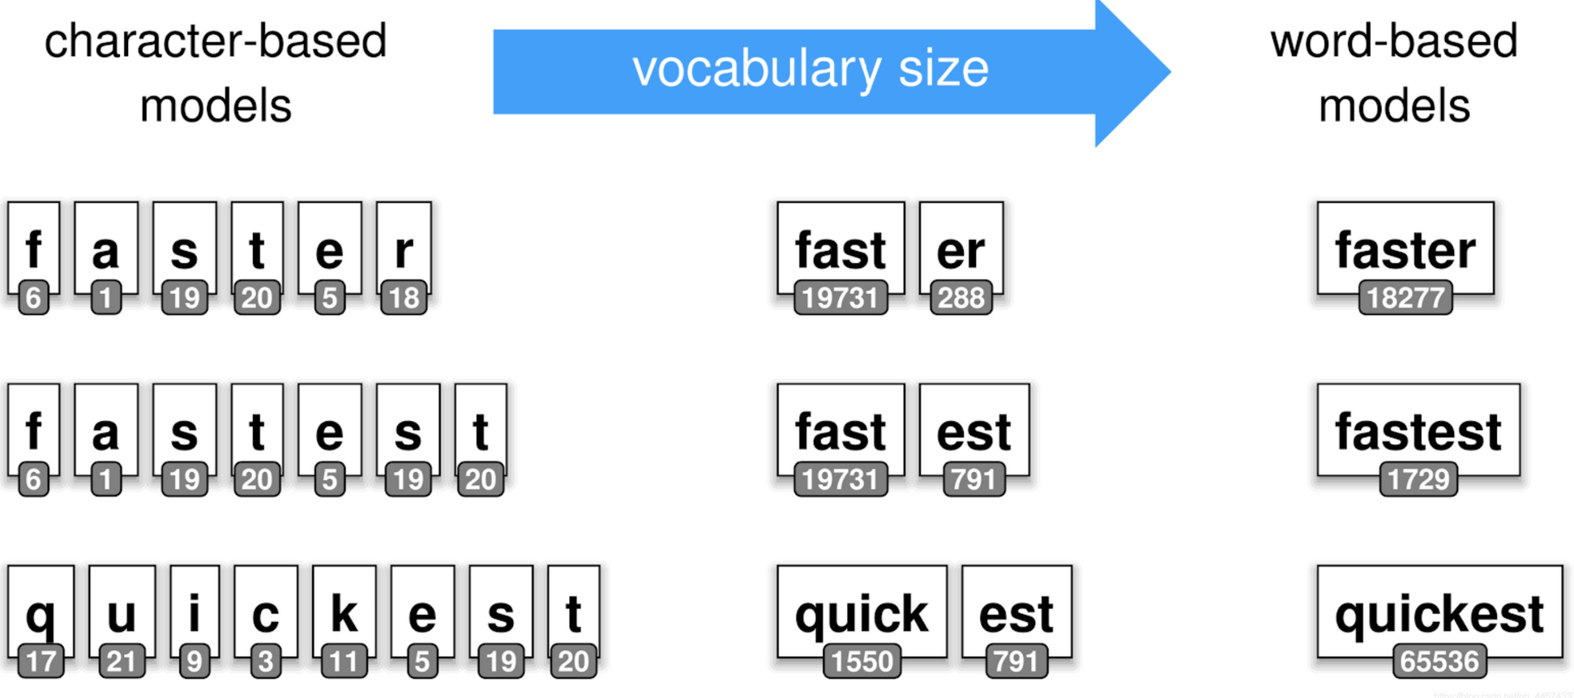
What is the input?
https://tiktokenizer.vercel.app/

Slide 5
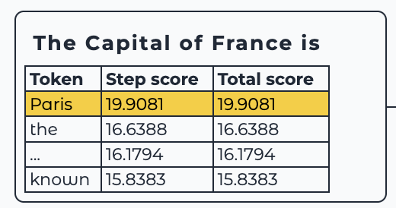
What is the output?

Slide 6
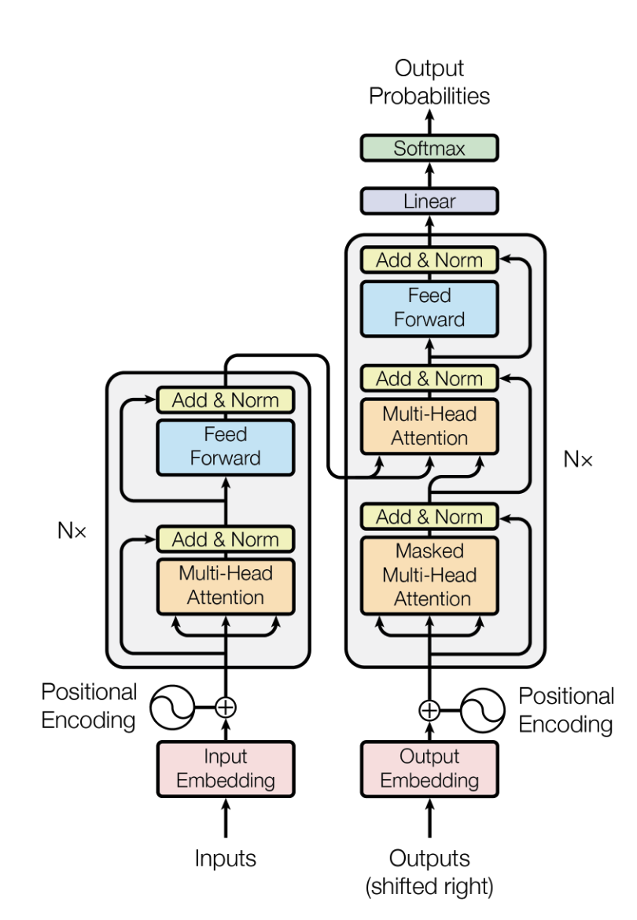
What is the model arch algorithm?

Slide 7
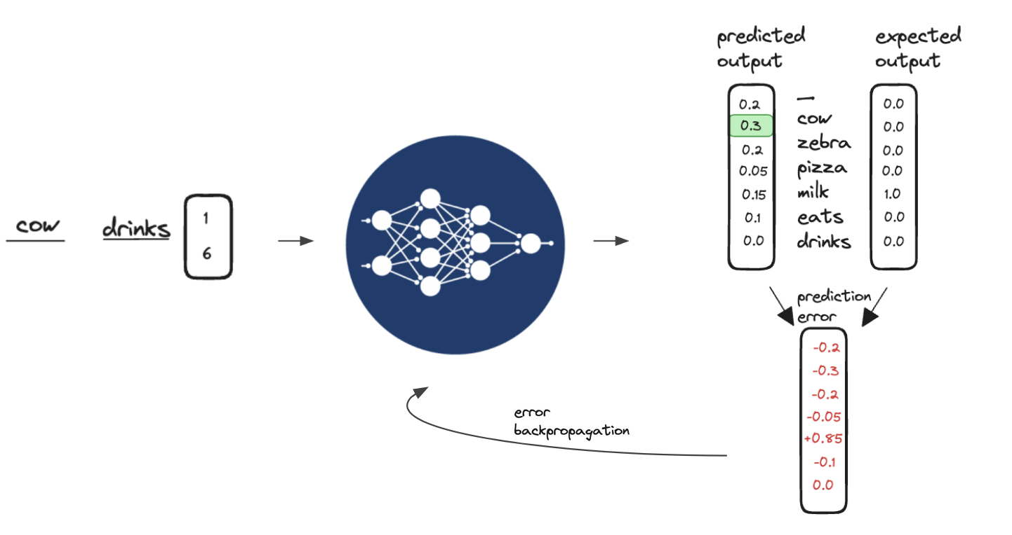
What is the learning algorithm?

Slide 8
ML Basics
1.What is the input? -tokens
2.What is the output? -token probabilities
3.What is the model architecture? -transformers
4.What is the learning algorithm? -self-supervised learning
(Stochastic Gradient Descent - error back propagation)

Slide 9
DEMO
Spelling/Counting

Slide 10
LLM History
2018 - Transformer paper (Attention is all you need)
2020 - GPT3 (Language Models are Few-Shot Learners)
2022 - ChatGPT (GPT 3.5 + RLHF)
2024 - Deepseek (R1-Zero & R1)

Slide 11
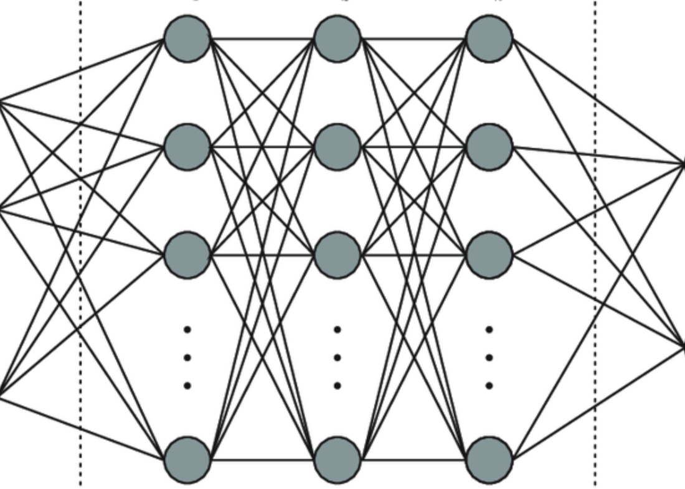
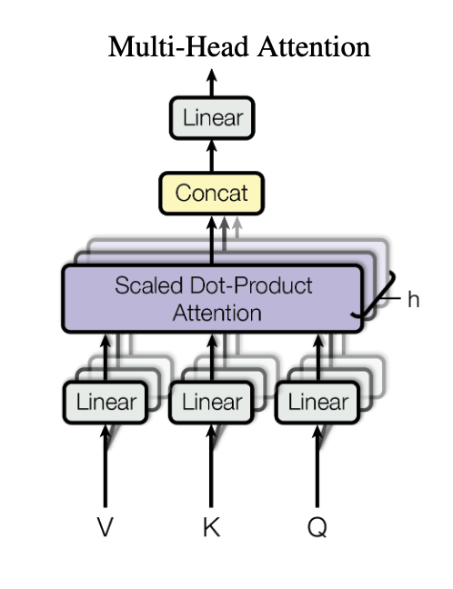
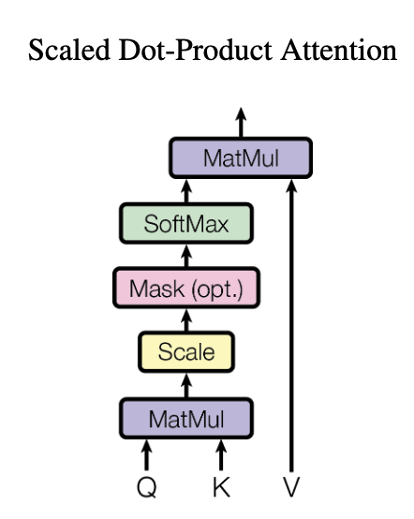
LLM History
2018 - Transformer paper (Attention is all you need)
- basic language model architecture
- smarter / more efficient way to combine parameters

Slide 12
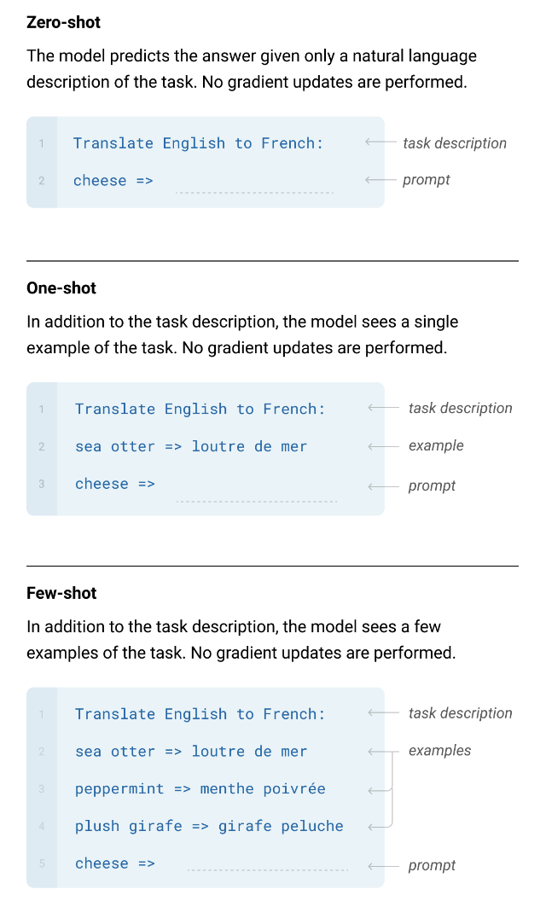
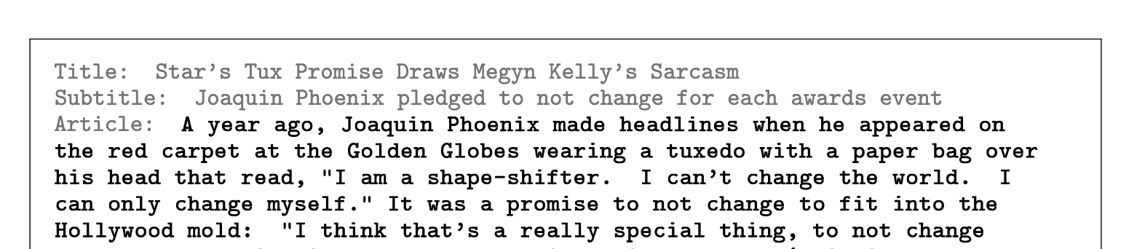
LLM History
2020 - GPT3 (Language Models are Few-Shot Learners)
- 10X scale of previous models
- can generate human-like text - news articles
- performs language tasks without task-specific tuning
(emergent SOTA capabilities)
Translation
Question-answering
Unscrambling words
3-digit arithmetic.

Slide 13
DEMO
translate to hungarian
bear => medve strawberry =>
Llama3.1-405b-base

Slide 14
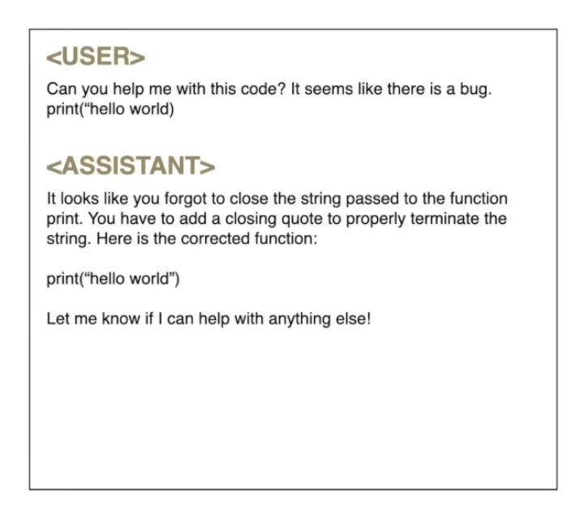
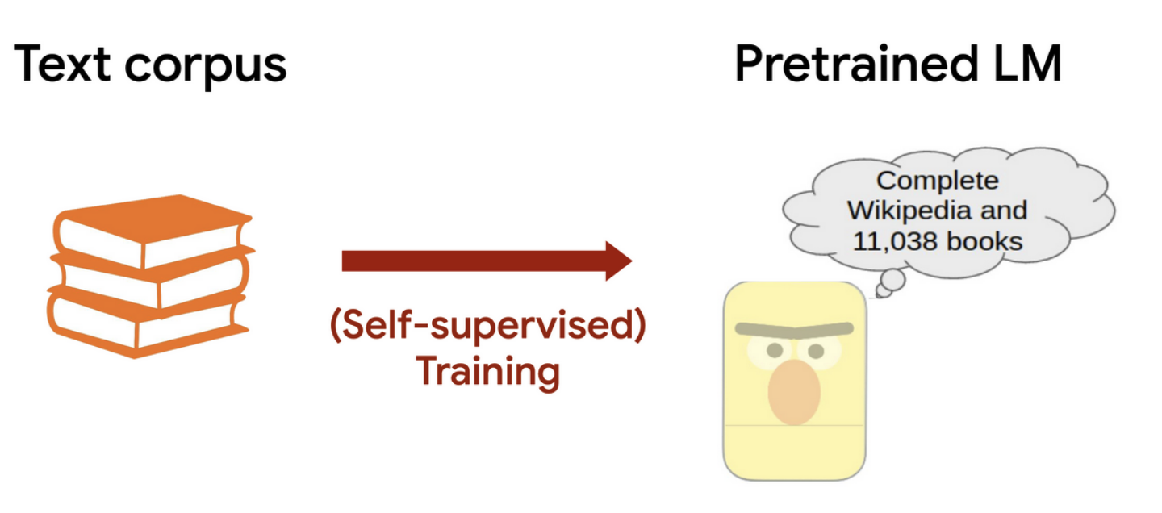
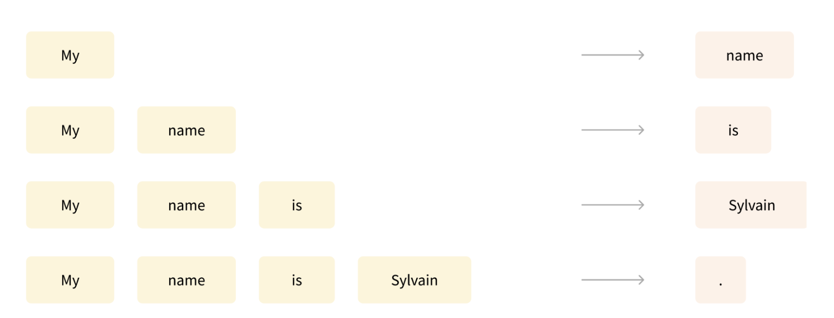
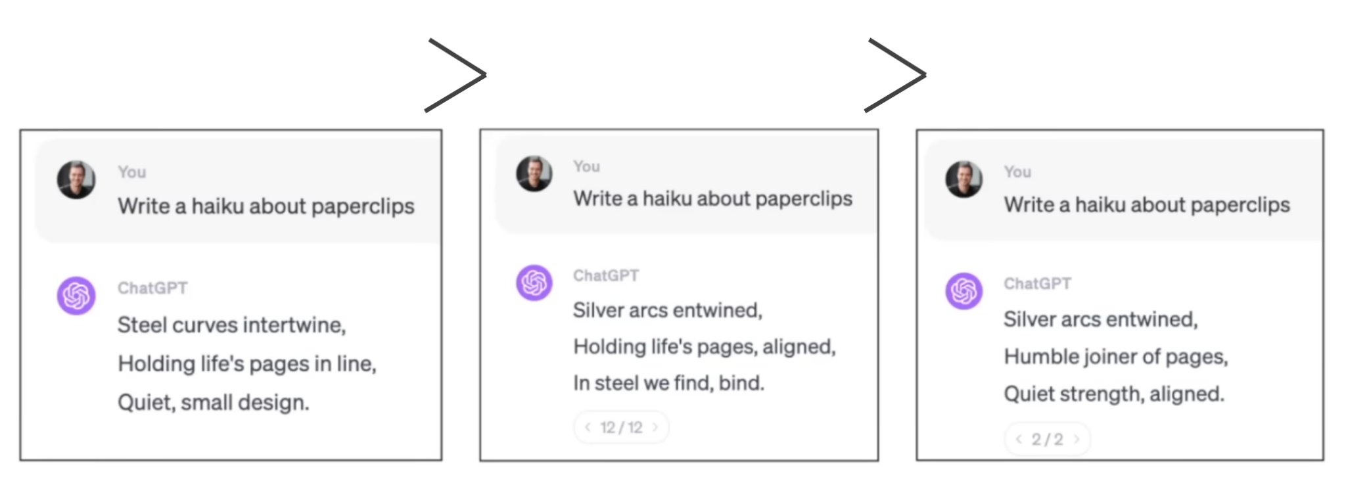
LLM History
2022 - ChatGPT (GPT 3.5 + RLHF)
- base models vs instruction following/assistant models
- raw text corpus vs special format conversation data
- human preference feedback

Slide 15
DEMO
what is 2 * 55 minus 13?
Llama3.1-405b-base
vs
Llama3.1-405b (instruction trained model)

Slide 16
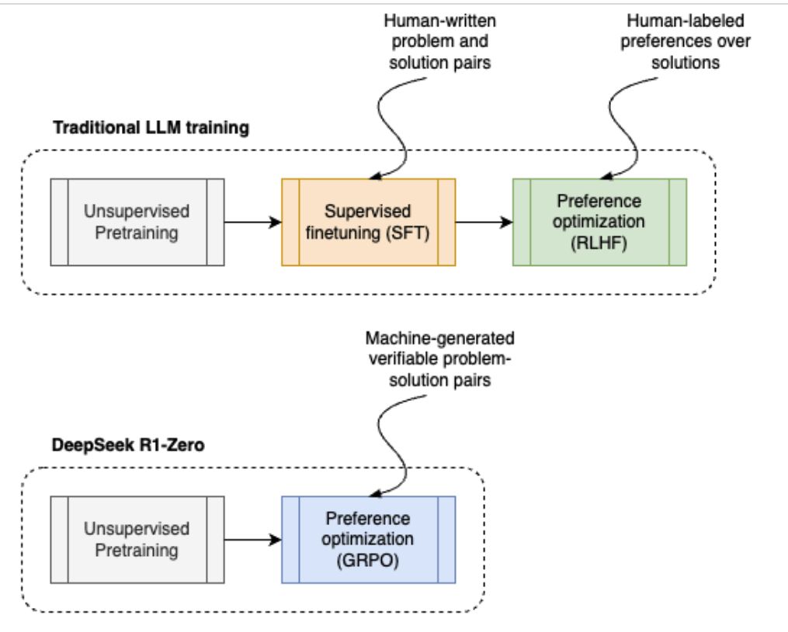
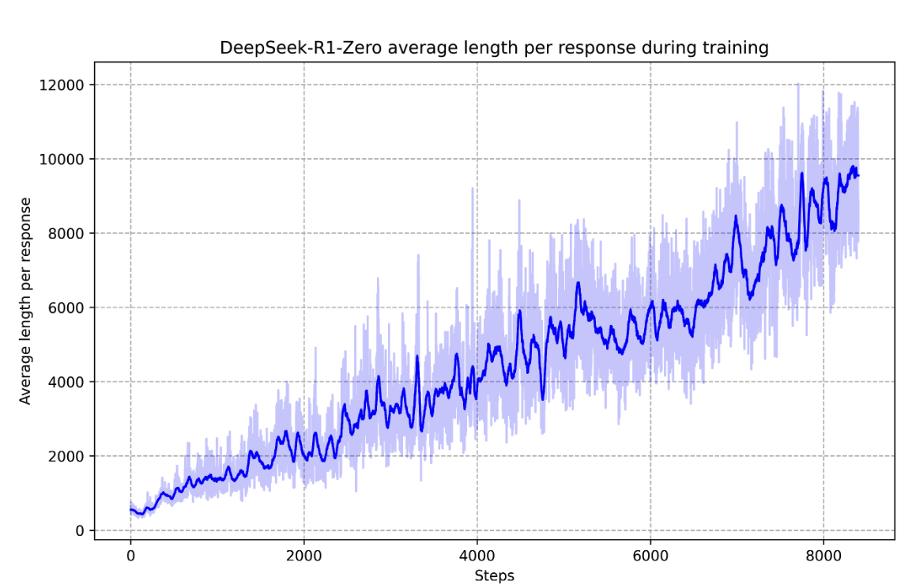
LLM History
2024 - Deepseek (R1-Zero & R1)
- think before answering - reasoning/thinking models
- human written problem-solution pair data set
- explicit teaching
vs
- LLM generated solution to verifiable problems
- filter based on accuracy
- naturally emerged, self-evolution
- reevaluation, explore alternatives
- solutions with optimal reasoning
- longer generated response usually better,
more “time/tokens” for the model to “think/compute”

Slide 17
DEMO
what is 2971 * 98?
Llama3.1-405b (instruction trained model)
Vs
Deepseek-r1 (reasoning model)

Slide 18
LLM History
2018 - Transformer paper (Attention is all you need)
- basic language model architecture
2020 - GPT3 (Language Models are Few-Shot Learners)
- human-like text and language task without specific tuning
2022 - ChatGPT (GPT 3.5 + RLHF)
- from base models to instruction following/assistant models
2024 - Deepseek (R1-Zero & R1)
- true Reinforcement Learning - reasoning/thinking models

Slide 19
HuggingFace abstraction
InferenceClient API
Pipelines API
Models API

Slide 20
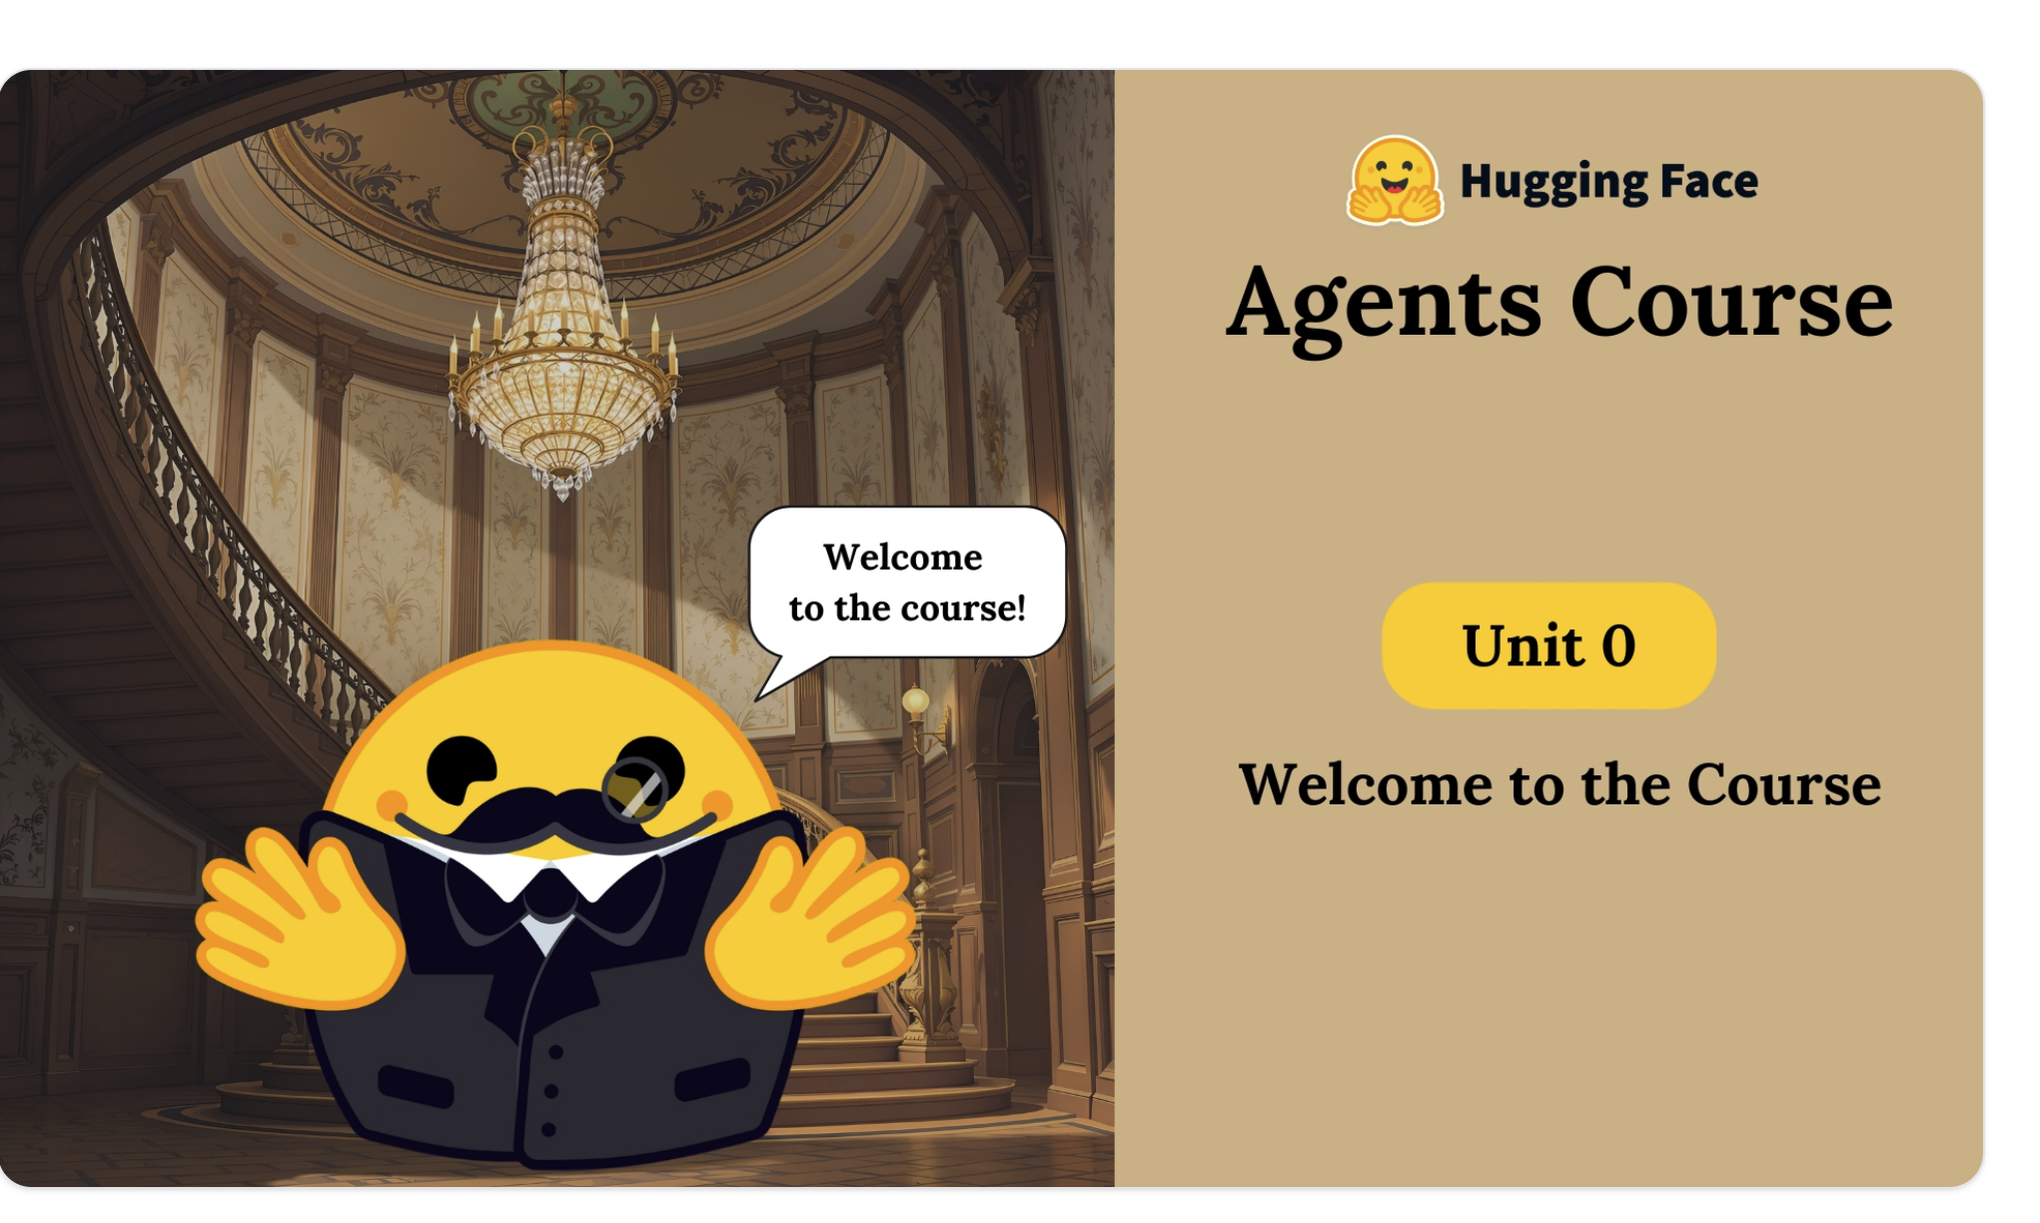
Agent
https://huggingface.co/learn/agents-course/unit0/introduction

Slide 21
Agent
LLM + Tools

Slide 22
Tool use
what is 2 * 55 minus 13?
Tool - a function with clear goal, description, inputs, outputs
Calculator tool - which can add numbers

Slide 23
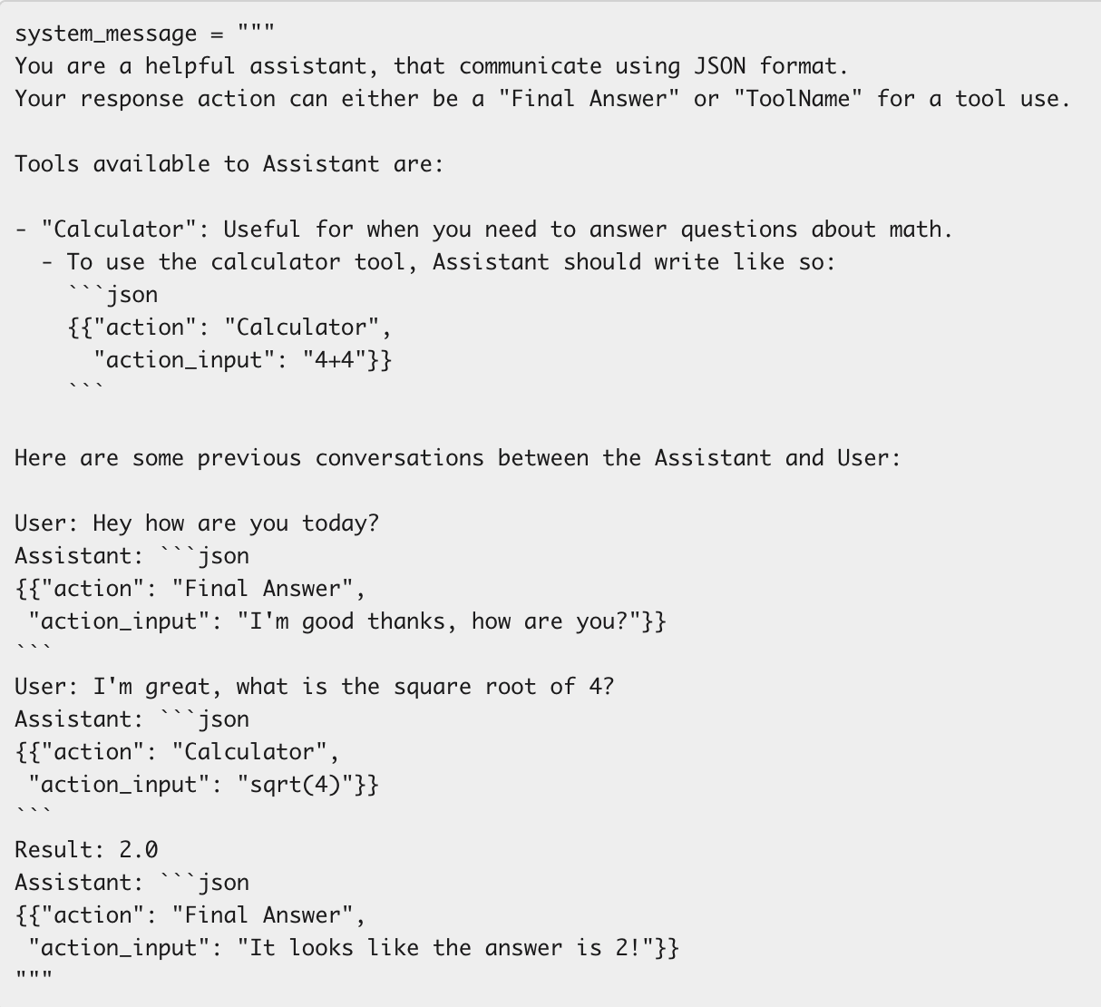
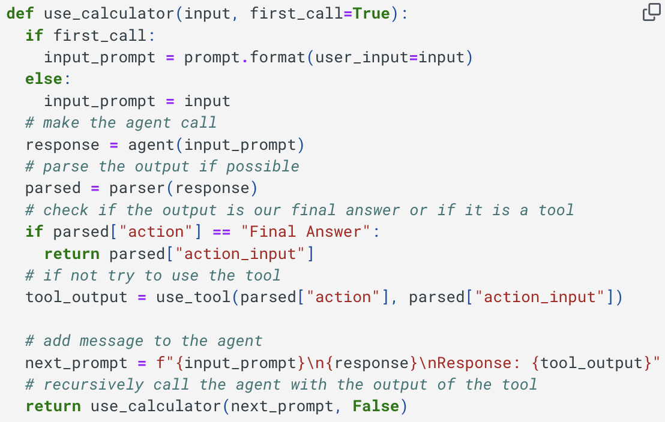
Tool use
what is 2 * 55 minus 13?

Slide 24
Agent
LLM + tool definitions + tool executor

Slide 25
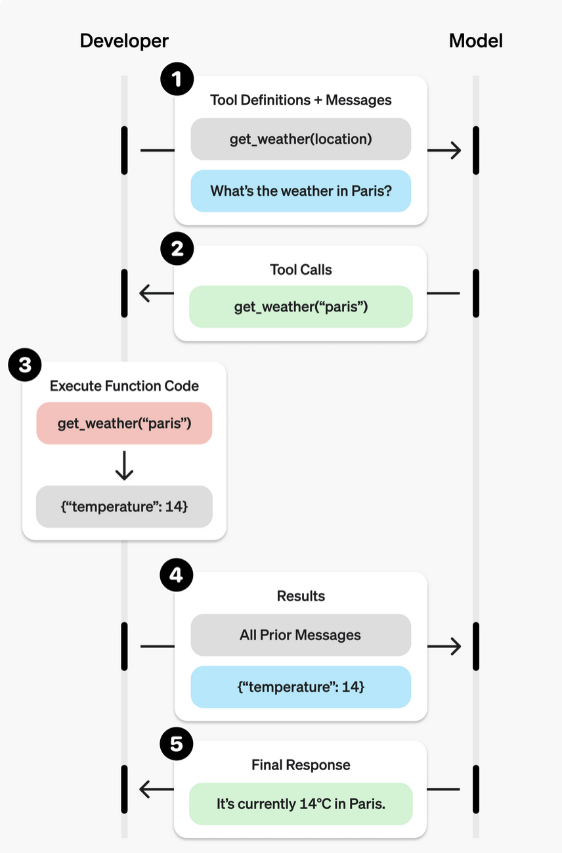
LLM History
2023 - Tool use / Function calling
- connect LLM to external tools
- train model with available list of tools
(description, input format)
- model can automatically decide
- to generate output normally
- or to use a tool - and generate tool input
- tool invocation is done “outside” of the llm

Slide 26
from powerful models
to artfully curated context
https://thelongcontext.com/

Slide 27
making learning engaging
notebooklm.google.com

Slide 28
References
HuggingFace Agent course -
https://huggingface.co/learn/agents-course/unit0/introduction
deeplearning.ai Agent course -
https://www.deeplearning.ai/short-courses/building-code-agents-with-hugging-face-smolagents/
Creating interactive game using a book and long context LLM -
https://thelongcontext.com/
Learn, by converting files into a podcast -
notebooklm.google.com

